Slide 1
METALS AND NON-METALS
ELEMENT
METALS
METALLOIDS
NON-METALS

Slide 2
Overview of the Chapter
Metals - Physical properties
Non-metals - Physical properties
Metals - Chemical properties
Reaction of metals with oxygen
Reaction of metals with water
Reaction of metals with acids
Reaction of metals with solutions of other metal salts Reaction of metals with non-metals
Properties of ionic compounds
Occurrence of metals
Rectivity series
Extraction of metals of high reactivity
Extraction of metals of medium reactivity Extraction of metals of low reactivity
Refining of metals
Corrosion of metals
Prevention of corrosion

Slide 3
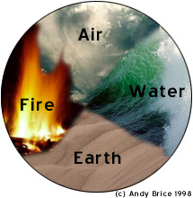
Elements
Science has come along way since Aristotle’s theory of Air, Water, Fire, and Earth.
Scientists have identified 92 Natural elements, and created about 28 others.
Notes:
3

Slide 4
Elements
The elements, alone or in combinations, make up our bodies, our world, our sun, and in fact, the entire universe.
Notes:
4

Slide 5
The most abundant element in the earth’s crust is oxygen.

Slide 6
Properties of Metals
Metals appear to the left of the dark ziz-zag line on the periodic table. Most metals are solid at room temperature.
Notes:
6

Slide 7
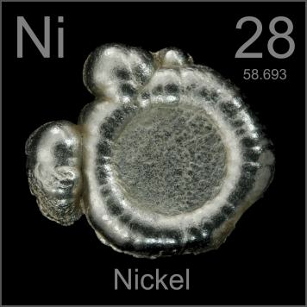
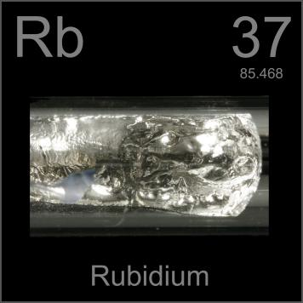
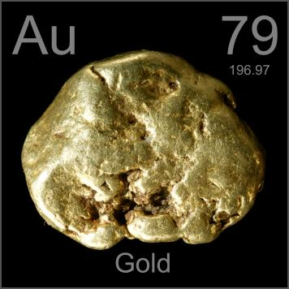
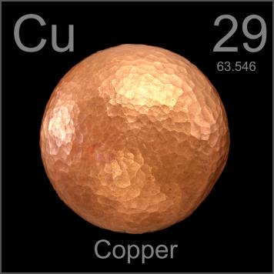
Physical Properties of Metals
Notes:
7

Slide 8
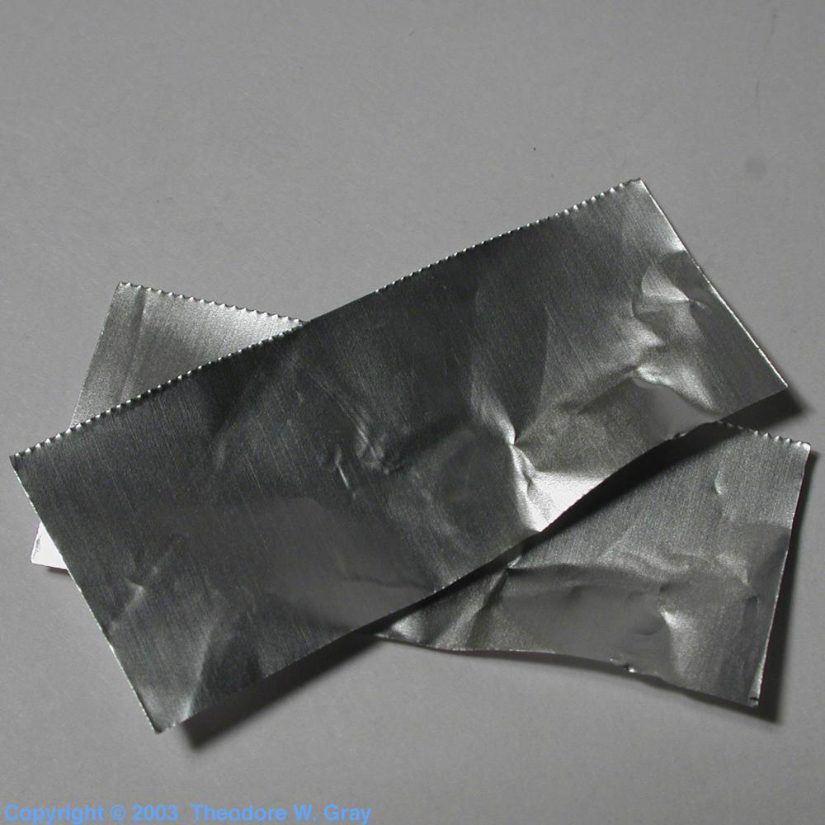
Malleable
Metals can be hammered into sheets
Notes:
8

Slide 9
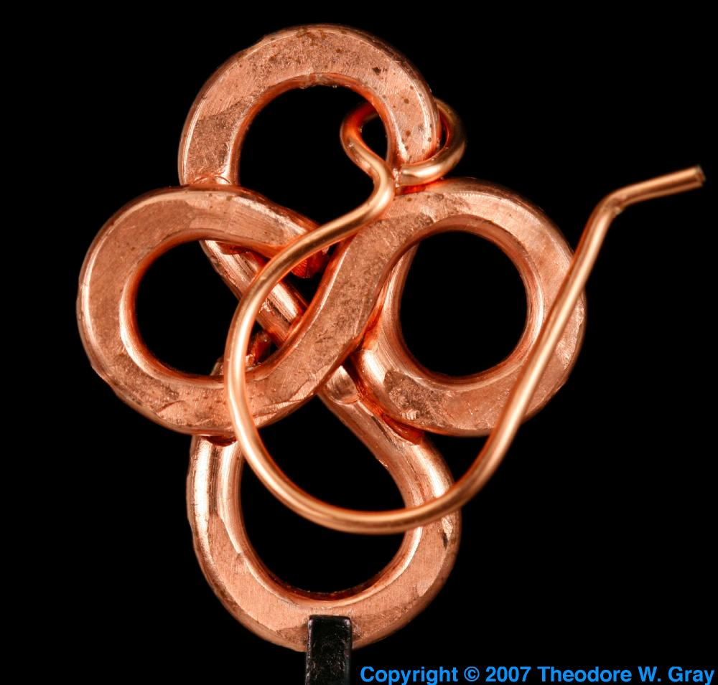
Ductile
Ductility: Drawn into thin wires. Most ductile: Gold/ aurum Au, silver/ argentum Ag. One gram of gold can be drawn into a wire of 2 km length
Notes:
9

Slide 10
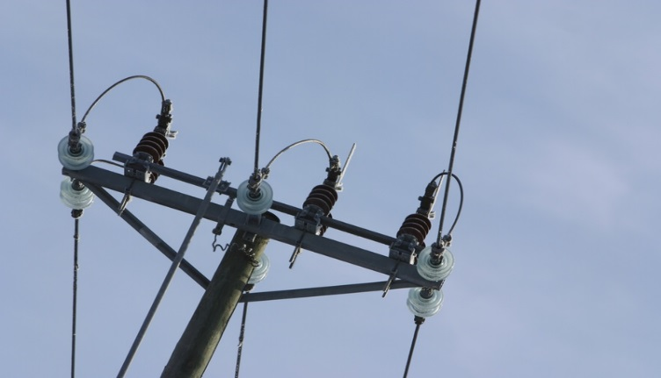
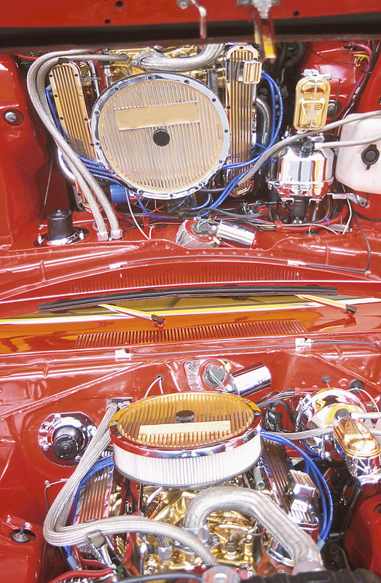
Conductor
Conduction of heat: Good conductors of heat; have high melting points. Silver Ag and copper/ cuprum Cu best conductors of heat. Lead/ plumbum Pb and mercury poor conductors of heat
Conduction of electricity: Good conductors of electricity. Electric wires are made of Cu having a outer insulation of PVC (polyvinyl chloride)
Notes:
10

Slide 11
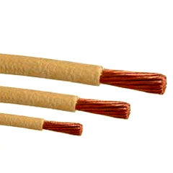
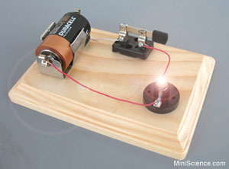
Conductor
Metals are good conductors of electricity.
Copper, silver, and gold are good electrical conductors. In a conductor, electric current can flow freely. Since metals have free electrons, they can carry a charge easily.
Copper Wiring

Slide 12
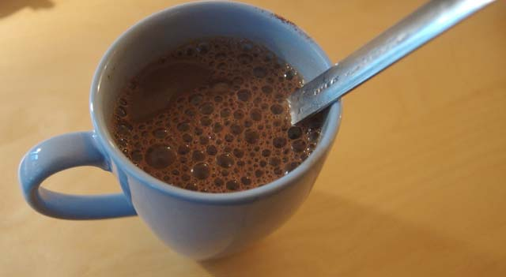
When you leave a spoon in a cup of hot drink, the bit poking out of the drink gets hot. Why? Conduction!
METALS are the best conductors of heat.
This is because the electrons in metals move more freely than in non-metals, allowing the heat energy to travel across the metal.
For example, when the spoon touches the hot drink, the heat from the drink excites the electrons in the metal, and the electrons transfer the energy from one electron to another, carrying the heat all the way up the spoon quickly.
Best conductors: silver and copper

Slide 13
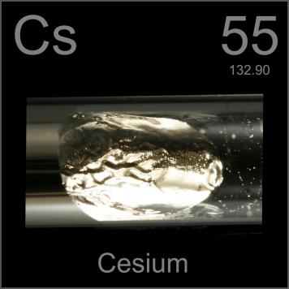
Lustre
Lustre: Shine in their pure state, polished to give a highly reﬂective surface
Notes:
13

Slide 14
Solids
Solids: At room temperature.
Exceptions: Mercury/ hydrargyrum Hg and gallium Ga are in liquid state at room temperature

Slide 15
Melting point and Boiling point
Melting point and Boiling point: High. Tungsten/ wolfram W highest melting point; sodium Na and potassium K low melting points

Slide 16
Sonorous
Sonorous: Produce a sound on striking a hard surface
e.g. bells

Slide 17
Hardness
Hardness: Generally hard, differs from metal to metal.
Alkali metals like sodium Na and potassium K are soft metals and can be cut easily with a knife

Slide 18
PHYSICAL PROPERTIES OFNON-METALS
Either in solid or gaseous state.
Exception: Bromine Br is in liquid state
Usually do not have lustre.
Exception: Iodine I
Do not possess the property of hardness. Exception: Carbon C in the form of diamond. It is the hardest substance known which also has a high melting and boiling point
Do not conduct electricity. Exception graphite (allotrope of carbon)

Slide 19
Metalloids
Metalloids possess both the properties of metals as well as non-metals e.g. silicon Si, germanium Ge, antimony/ stibium Sb, etc.

Slide 20
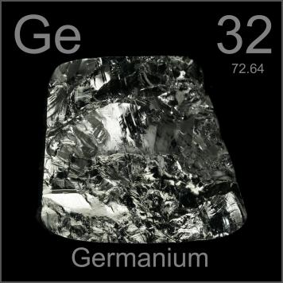
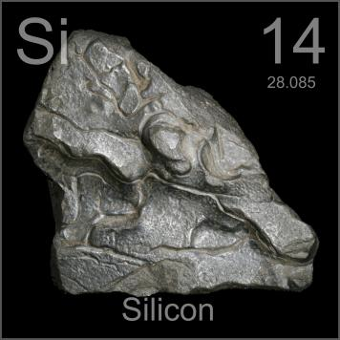
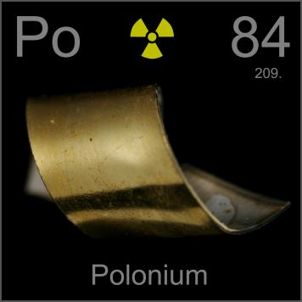
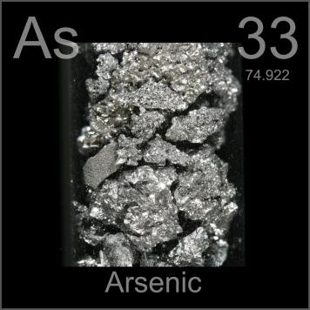
Metalloids
Notes:
20

Slide 21
Physical properties of metals
M- Malleable and Ductile
E- Electric conductive
T - Tensile
A- Alloy formation
L- Lustrous
S- Sonorous

Slide 22
CHEMICAL PROPERTIES OF METALS
Reaction of metals with oxygen
Almost all metals react with oxygen to form metal oxide, but the reactivity differs for different metals
Sodium and Potassium are the most reactive metals.
Sodium reacts with oxygen in air at room temperature to form sodium oxide. Hence, sodium is stored under kerosene oil to prevent its reaction with oxygen, moisture and carbon dioxide
4Na + O₂ → 2Na₂O

Slide 23
Reaction with oxygen :-
Metals react with oxygen to form metal oxides.
When copper is heated it combines with oxygen to form copper oxide. 2Cu + O₂ 2CuO
When aluminium is heated it combines with oxygen to form aluminium oxide. 4Al + 3O₂ 2Al₂O₃
Some metal oxides are basic oxides because they react with water to form bases.
4Na + O₂ 2Na₂O
Na₂O + H₂O 2NaOH K + O₂
K₂O
2KOH
K₂O + H₂O
Some metal oxides show acidic and basic properties. They are called amphoteric oxides. Aluminium oxide, Zinc oxide etc.
Al₂O₃ + 6HCl
(basic)
Al₂O₃ + NaOH
(acidic)
2AlCl₃ + 3H₂O
NaAlO₂ + H₂O
(Sodium aluminate)

Slide 24
Chemical properties of metals
Reaction with oxygen :-
Metals react with oxygen to form metal oxides.
When copper is heated it combines with oxygen to form copper oxide.
2Cu +O₂ 2CuO
When aluminium is heated it combines with oxygen to form aluminium oxide.
4Al + 3O₂ 2Al₂O₃
Some metal oxides are basic oxides because they react with water to form bases.
4Na + O₂ 2Na₂O

Slide 25
The reactivity of different metals with oxygen is different
Metals like potassium and sodium react vigorously with oxygen and catch fire if kept in open. Hence they are stored in kerosene to prevent burning.
If magnesium is heated, it burns with a bright flame. If iron is heated it glows brightly.
If copper is heated it does not burn but forms a black coating of copper oxide.
Silver and gold does not react with oxygen even at high temperature.
Some metals like magnesium, aluminium, zinc, lead etc. forms an oxide layer over it which prevents further oxidation. They are called self protecting metals.

Slide 26
Amphoteric oxides
Metal oxides are usually basic in nature but
some metal oxides such as aluminium oxide Al₂O₃ and zinc oxide ZnO react both with acids as well as bases to produce salt and water
Al₂O₃ + 6HCl → 2AlCl₃ + 3H₂O
Al₂O₃ + 2NaOH → 2NaAlO₂ (sodium aluminate) + H₂0

Slide 28
ii) Reaction with water :-
Metals react with water to form metal oxides or metal hydroxides and hydrogen.
2Na +2H₂O 2NaOH + H₂
2K + H₂O Ca + H₂O
2KOH + H₂ Ca(OH)₂ + H₂
2Al + 3H₂O
3Fe + 4H₂O
Al₂O₃ + H₂ Fe₂O₃ + 4H₂

Slide 29
Reaction of metals with water
Metals like potassium and sodium react vigorously with cold water
Sodium reacts with water to evolve hydrogen which immediately catches fire producing a lot of heat (Exothermic reaction)
2K + 2H₂O → 2KOH + H₂ + heat energy
2Na + 2H₂O → 2NaOH + H₂ + heat energy

Slide 30
The reactivity of different metals with water is different :-
Sodium and potassium react violently with cold water to form sodium hydroxide and hydrogen and catches fire.
Calcium reacts less violently with water to form calcium hydroxide and water and does not catch fire.
Magnesium reacts only with hot water to form magnesium hydroxide and hydrogen.
Metals like aluminium, iron and zinc react only with steam to form the metal oxides and hydrogen.
Metals like lead, copper, silver and gold do not react with water.

Slide 31
Reaction of Na with water

Slide 32
Calcium reacts with water less vigorously. The heat evolved is not sufficient for hydrogen to catch fire
Instead, calcium starts ﬂoating because the bubbles of hydrogen gas formed stick to the surface of the metal
Ca + 2H₂O → Ca(OH)₂ + H₂
Magnesium reacts with hot water to form magnesium hydroxide Mg(OH)₂ and hydrogen H₂. Magnesium also starts ﬂoating since the bubbles of hydrogen gas stick to its surface.

Slide 33
Metals like aluminium, iron and zinc do not react either with cold or hot water but they react with steam to form metal oxide and hydrogen (g)
2Al + 3H₂O → Al₂O₃ + 3H₂
3Fe + 4H₂O → Fe₃O₄ + 4H₂
Metals like gold, silver, and copper do not react with water at all

Slide 34
Reaction of metals with acids
Metals react with acids to give salt and hydrogen gas
Reaction with dilute hydrochloric acid HCl
Formation of metal chloride and hydrogen gas The reactivity decreases in the order,
Mg > Al > Zn > Fe
Mg + 2HCl → MgCl₂ + H₂↑
2Al + 6 HCl → 2AlCl₃ + 3H₂↑ Zn + 2HCl → ZnCl₂ + H₂↑
Fe +2HCl → FeCl₂ + H₂↑
No bubbles are seen in case of copper. This shows that copper does not react with dilute hydrochloric acid

Slide 35
Reaction with Sulphuric acid (H₂SO)₄
Formation of metal sulphate and hydrogen gas
Fe + H₂SO₄ → FeSO₄(aq) + H₂(g)
Iron Fe reacts vigorously and exothermically with sulfuric acid to produce iron (II) sulfate
Zn + H₂SO₄ → ZnSO₄(aq) + H₂(g) Mg + H₂SO₄ → MgSO₄(aq) + H₂(g)

Slide 36
Reaction with Nitric acid (HNO₃₎
Hydrogen gas is not evolved when a metal reacts with nitric acid, as it is a strong oxidizing agent
It oxidizes the hydrogen to water and itself gets reduced to any of the nitrogen oxides (N₂0 nitrous oxide, NO nitric oxide, NO₂ nitrogen dioxide)
But magnesium and manganese react with dilute HNO₃ to evolve hydrogen gas
Mg(s) + 2HNO₃(aq) → Mg(NO₃)₂(aq) + H₂(g)
magnesium + nitric acid → magnesium nitrate + hydrogen

Slide 37
Reactions of metals with air, water and acids
Element | Reaction with Air | Reaction with Water | Reaction with Acid
Potassium K Sodium Na | Burns vigorously to form oxides | With cold water forms hydrogen gas and alkaline hydroxide solution. React with decreasing vigour down the series till Ca | Violent reaction to give hydrogen gas and salt solution
Calcium Ca Magnesium Mg Aluminium Al Zinc Zn Iron Fe | Burn with decreasing vigour down the series | Mg reacts with hot water to fomi magnesium hydroxide and hydrogen gas. For Al, Zn and Fe, no reaction with cold and hot water. With steam forms metal oxide and hydrogen gas | React to form hydrogen gas and salt solution with decreasing vigour down the series

Slide 38
AQUAREGIA
Aquaregia is a highly corrosive as well as fuming liquid and is one of the few reagents that is able to dissolve gold and platinum
It is a freshly prepared mixture of concentrated hydrochloric acid and concentrated nitric acid in the ratio of 3:1
Aqua regia (Latin, lit. "royal water" or "king's water") was so named by alchemists because it can dissolve the noble metals gold and platinum

Slide 39
Reactions of metals with solutions of other metal salts
Put an iron nail in the solution of copper sulphate Fe(s) + CuSO₄(aq) → Cu(s) + FeSO₄(aq)
metal A + salt solution B → salt solution A + metal B
The iron nail gets coated with a reddish brown colour copper and the blue colour of copper sulphate solution fades out
In this reaction more reactive iron has displaced copper which is less reactive from the copper sulphate solution

Slide 40
This reaction is known as displacement reaction. The brown coating on the iron nail shows that copper is deposited on the iron nail by displacing iron
The greenish colour of the solution in the test tube shows that Fe²⁺ ions are present in the solution. This shows that iron is more reactive than copper, as Fe²⁺ ions have displaced Cu²⁺ ions from copper sulphate solution

Slide 41
A more reactive metal displaces a less reactive metal from its salt solution. (Displacement reaction)
Magnesium displaces copper from copper sulphate solution. Mg + CuSO₄ MgSO₄ + Cu
Zinc displaces copper from copper sulphate solution. Zn + CuSO₄ ZnSO₄ + Cu
Iron displaces copper from copper sulphate solution Fe + CuSO₄ FeSO₄ + Cu
after 15 – 20 minutes

Slide 42
Anodising
Anodising is a process of forming a thick oxide layer aluminium. Aluminium develops a thin oxide layer of oxide
exposed
This aluminium oxide coat makes it to further corrosion. The resistance can be
improved by making the oxide layer thicker
In this technique aluminium article is used as an anode. Electrolyte used is dilute sulphuric acid. The anode reaction results in formation of a black coloured thin film of aluminium oxide on the surface of anode

Slide 43
Anodising
Anodising is a process of making thick layer of aluminium.
This aluminium oxide coat makes it to further corrosion
This resistance can be imprved by making oxide layer thicker
In this technique aluminium article is used as an anode. Electrolyte used is dilute sulphuric acid. The anode reaction results in formation of a black coloured thin film of aluminium oxide on the surface of anode

Slide 45
By putting appropriate dyes in the electrolytic bath, coloured surface with decorative finish can be achieved
Kitchen articles like anodised pressure cookers, anodised pans and also frames of sliding windows are the applications of anodising techniques

Slide 46
Reactivity series of metals
The arranging of metals in the decreasing order of their reactivity is called reactivity series of metals.
K - Potassium Na - Sodium Ca - Calcium
Mg - Magnesium Al - Aluminium Zn - Zinc
Fe - Iron
Pb - Lead
H - Hydrogen
Most reactive
Reactivity decreases
Cu - Copper Hg - Mercury Ag - Silver Au - Gold
Least reactive

Slide 47
4) How do metals an non metals react ?
Metals :- lose electrons and become positive ions. So they are called electropositive elements.
Eg :- The atomic number of sodium is 11, its electronic configuration is 2,8,1, it has 1 valence electron. It loses 1 electron and forms a sodium
ion Na ⁺
Na Na ⁺ + 1 e⁻ AN = 11
EC = 2,8,1
Mg AN = 12
EC = 2,8,2
2,8
Mg ²⁺ + 2 e⁻
2,8
Non metals :- gain electrons and become negative ions. So they are called electro negative elements.
Eg:- The atomic number of chlorine is 17, its electronic configuration is
2,8,7, it has 7 valence. It gains 1 electron and forms a chloride ion Cl ⁻
Cl + 1 e⁻ AN = 17
EC = 2,8,7
O + 2e⁻
Cl ⁻
2,8,8
_{O} 2-

Slide 48
5a) Formation of sodium chloride molecule – NaCl
-
+
Na . +
AN = 11
EC = 2,8,1
xx
xx
x _{Cl} x
.
Na
x _{Cl} x
NaCl
x
x
xx
xx
AN = 17
EC = 2,8,7
The atomic number of Na is 11, its electronic configuration is 2,8,1, it has 1 valence electron, it loses 1 electron to form Na ⁺ ion. The atomic number of Cl is 17, its electronic configuration is 2,8,7, it has 7 valence electrons,
it gains 1 electron to form Cl ⁻ ion. Then the attraction between the Na ⁺ ion and Cl ⁻ ion results in the formation of sodium chloride molecule – NaCl.

Slide 49
b Formation of Magnesium chloride molecule – MgCl₂)
Mg Mg ²⁺ + 2e ⁻
AN = 12 EC = 2,8,2 | 2,8
Cl + 1e ⁻ |  | Cl ⁻
AN = 17
EC = 2,8,7 |  | 2,8,8
_{x} xx _{x}
-
.Cl
xx
.
Cl _{x}
x
x
.
x x xx
2+
x
x x
xx
Mg +
Mg
-
MgCl
x _{Cl} x
.
2
x
x
x x ^{x}
Cl x x x
The AN of Mg is 12, its EC is 2,8,2, it has 2 valence electrons, it loses 2 electrons to form Mg ²⁺ . The AN of Cl is 17, its EC is 2,8,7, it has 7
valence electrons, it gains 1 electron to form Cl ⁻. Then the attraction
between Mg ²⁺ ion and 2 Cl ⁻ ions results in the formation of Magnesium chloride molecule – MgCl .

Slide 50
6) Ionic compounds (Electrovalent compounds) :-
Ionic compounds are compounds formed by the transfer of electrons from a metal to a non metal.
Properties of ionic compounds :-
i) They are formed by the transfer of electrons and are made up of ions.
They are crystalline solids.
They have high melting points and boiling points.
They are soluble in water but insoluble in organic solvents (like petrol, kerosene etc.)
They conduct electricity in molten state or in solution.

